Slide 1
ALU Calculator
EC311 Final Project
Moumit Bhattacharjee, Arnav Shah, Bryan Ginenthal

Slide 2
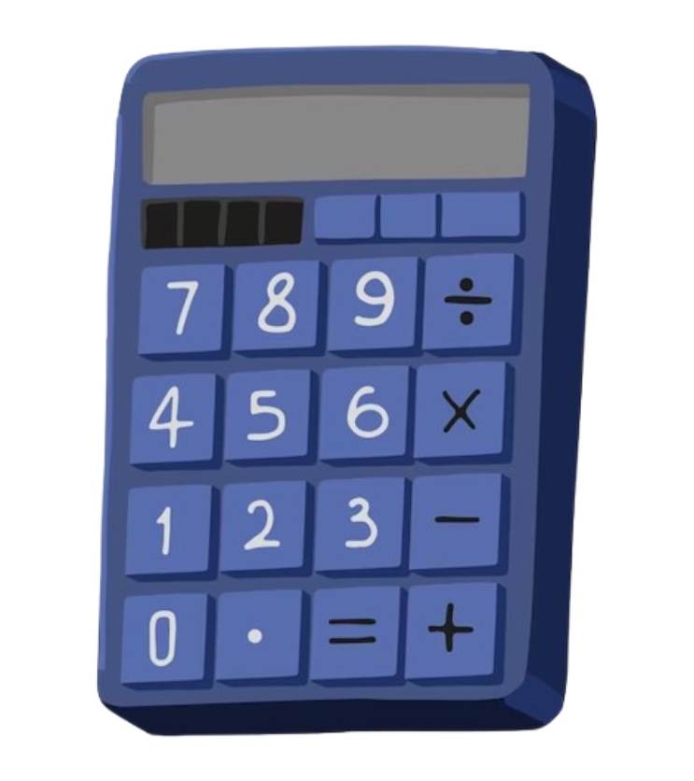
Goal/Motivation
Goal:
To design and implement an Arithmetic Logic Unit (ALU) calculator capable of performing basic arithmetic and logical operations without relying on a complex processor and providing instant results on a seven-segment display for easy readability.
Our Motivation:
To deepen our understanding of digital logic design and the fundamental operations of a CPU.
Apply the theoretical knowledge we learned in class in a practical project that has actual real-world applications.
Real-Life Application Example:
Embedded Systems: Used in devices like straightforward digital watches or simple calculators where basic computations are required without the complexity of a full CPU.
Notes:
Goal:
"Our primary goal with this project is to design and implement an Arithmetic Logic Unit (ALU) calculator. This calculator is capable of performing basic arithmetic and logical operations without the need for a complex processor.
Our hope was for our calculator to provide instant results displayed on a seven-segment display. This ensures that the outputs are easily readable and that there's minimal delay between input and output, enhancing the user experience."
Our Motivation:
"We were motivated to embark on this project to deepen our understanding of digital logic design. By constructing an ALU from scratch, we're getting hands-on experience with the building blocks of computer architecture.
This project allows us to bridge the gap between theory and practice. All the theoretical knowledge we've accumulated in class about logic gates, circuits, and CPU operations is being applied in a cool applicable way.
Real-Life Application Example:
"An excellent real-life application of our project is in the realm of embedded systems. These systems are found in devices that require basic computational capabilities without the overhead of a full-fledged CPU.
For instance, simple digital watches and basic calculators utilize similar ALU concepts. They perform essential computations efficiently and cost-effectively.
By understanding how to design and implement an ALU, we're gaining insights into how these everyday devices function. This knowledge is crucial for developing optimized hardware solutions in industries where resource constraints and efficiency are very important."

Slide 3

Functionality
Operations Performed:
8 Functions:
Arithmetic
Addition (001)
Subtraction (010)
Multiplication (011)
Division (100)
Modulo (101)
Logic
XOR (110)
AND (111)
OR (000)
User Interface:
Inputs provided via switches
Operation selection through a 3 bit mode selector.
Output:
Results displayed on a seven-segment display for immediate visual feedback. Arithmetic results converted to decimal values, and Logic results in binary.
Notes:
Operations Performed:
Our ALU calculator is designed to perform a total of 8 functions, thanks to our 3-bit mode selector which allows for 8 different operations.
Starting with the Arithmetic Operations:
When the mode selector is set to 000, we perform the Power operation, raising A to the power of B.
At 001, we have Addition, simply adding inputs A and B.
010 selects Subtraction, subtracting B from A.
With 011, we can do the multiplication of A and B.
100 is for Division where we divide A by B.
And 101 lets us calculate the Modulo, finding the remainder when A is divided by B.
Moving on to the Logic Operations:
110 performs a bitwise XOR between A and B.
Finally, 111 carries out a bitwise AND operation on A and B.
User Interface:
We've made the interface pretty straightforward. You provide inputs via the switches on the FPGA board.
Inputs A and B are both 4-bit numbers, so you can set them using the switches designated for each bit.
To select an operation, you use a 3-bit mode selector, also controlled by switches. This makes it easy to choose any of the 8 functions we just talked about.
Output:
The results are displayed on a seven-segment display, giving you immediate visual feedback.
For arithmetic results, we convert the output to decimal values to make them easy to read and understand.
For logic results, since they make more sense in binary, we display them in binary format on the display.

Slide 4
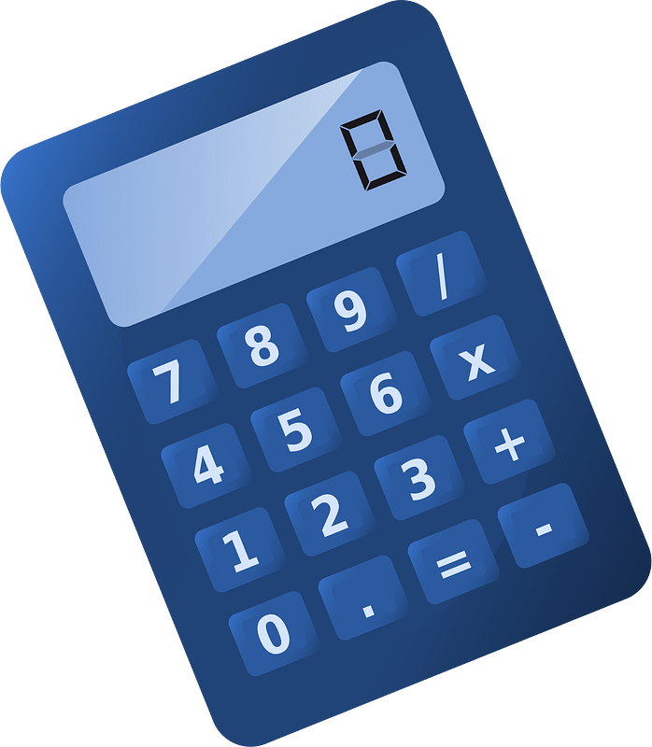
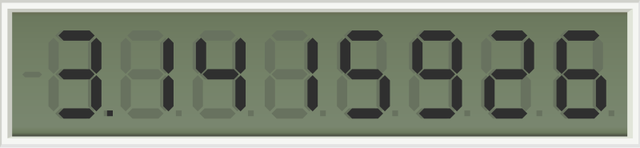
Specs
Requirements:
Switches control 2 4-bit inputs A and B
A 3-bit mode selector determines the operation to perform.
Arithmetic operations include addition, subtraction, multiplication, division, modulo, and power.
Logical operations include XOR and AND.
Carry adder required for multi-bit operations and overflow
Outputs are displayed on a seven-segment display, with arithmetic results in decimal and logical results in binary.
Constraints:
Limited to 8 distinct operations within a 3-bit selector system.
FPGA board has a predefined number of switches and display segments.
Computations are completed and displayed with minimal delay.
Multiplication, Division, Power, and Modulo don’t work in one clock cycle
Unable to display larger outputs due to the limitations of the 7-segment display.
Notes:
Requirements:
Let's start by discussing the key requirements for our ALU calculator.
First, we're using switches to control two 4-bit inputs, labeled A and B. This allows us to input values ranging from 0 to 15 for each operand.
We have a 3-bit mode selector that determines the operation to perform. With 3 bits, we can select among 8 different operations.
Our arithmetic operations include:
Addition
Subtraction
Multiplication
Division
Modulo
Power (Exponentiation)
For logical operations, we've included:
XOR (Exclusive OR)
AND
To handle multi-bit operations and potential overflow, a carry adder is required. This ensures accurate results when the sum exceeds the capacity of a single bit.
Outputs are displayed on a seven-segment display:
Arithmetic results are converted to decimal values for easy readability.
Logical results are displayed in binary since they're more meaningful in that format.
Constraints:
Our 3-bit mode selector limits us to 8 distinct operations. This means we had to choose the most essential operations to include.
The FPGA board we're using has a predefined number of switches and display segments. This limits the number of inputs we can handle and the complexity of outputs we can display.
We aim to have computations completed and displayed with minimal delay, providing immediate feedback to the user.
However, operations like Multiplication, Division, Power, and Modulo are more complex and don't complete in a single clock cycle. This means there might be a slight delay when performing these operations compared to simpler ones like addition or subtraction.
Another constraint is that we're unable to display larger outputs due to the limitations of the seven-segment display. It can only show numbers up to a certain size, so very large results can't be fully displayed.

Slide 5
Block Diagrams
Switch User Input
4-bit input A
4-bit input B
4-bit
A & B
3-bit mode selector
Clock
ALU
Add
Sub
Mult
Div
Mod
OR
XOR
AND
3-bit mode selector
Wait # clock cycles to complete calculations
Binary to Decimal Conversion if Arithmetic
Value shown on 7-segment display

Slide 6
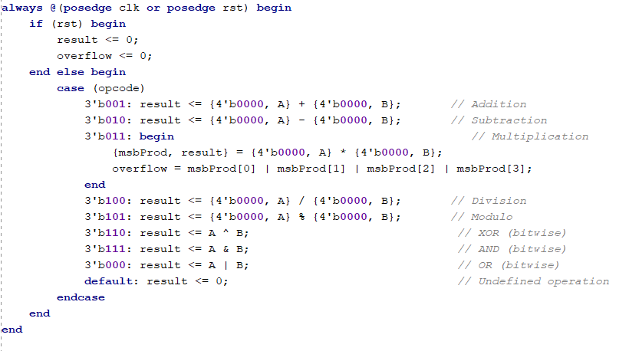
Code Snippets
ALU Operation and Result Generation
Multiplication:
The operands A and B are zero-extended to 8 bits before multiplication, ensuring the full product fits within the 8 bits.
The result is split into msbProd (most significant bits) and result (least significant bits). The first 4 bits of the product are stored in msbProd, and the next 4 bits in result.
Overflow is detected by checking if any bits in msbProd are set (msbProd[0] | msbProd[1] | msbProd[2] | msbProd[3]), indicating that the significant upper bits of the product contain non-zero values.

Slide 7
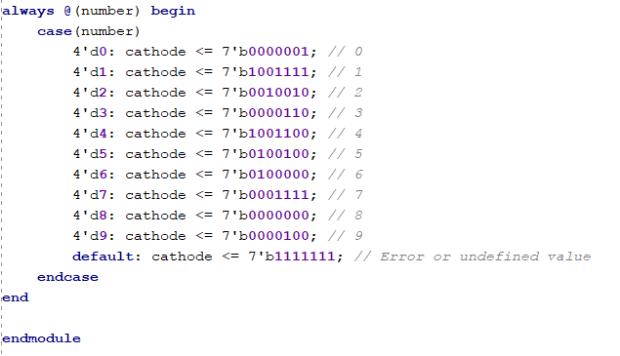
Code Snippets
7-Segment Decoder Logic: The module takes a 4-bit binary input (number) and converts it to a corresponding 7-segment display output (cathode).
Case Statement for Display Control: The case statement matches the 4-bit input to predefined 7-segment patterns for digits 0-9, controlling which segments to light up.
Error Handling: If the input is out of the valid range (0-9), the default case sets all segments to 1111111, indicating an error or undefined value.

Slide 8

Successes
Successfully executed all intended arithmetic and logic operations with minimal delay.
Tested all arithmetic and logic operations and successfully produces 8 bit results.
8 bit binary results successfully converts to cathode for the 7 segment display
Notes:
"So, we managed to get our ALU to perform all the arithmetic and logic operations we wanted, and it does them pretty quickly. Everything felt smooth and responsive."
"The seven-segment display turned out great! It shows the results accurately and right away, so users get instant feedback without any wait time."
"We also managed to display arithmetic results in decimal and keep the logic operations in binary
"We also took care of potential overflow issues in multi-bit calculations by using carry adders. This means even when we're dealing with bigger numbers, the results stay accurate, which is pretty important."

Slide 9

Failures/Lessons
Yet to Finish:
Test out the 7 segment display on the board
Test speed at which results show up, especially multiplication.
Possibly add a feature that allows user to toggle display in binary or decimal.
What We'd Do Differently:
Utilize multiplexing or additional displays to handle larger operands or have it display scientific notation.
Develop a more sophisticated input method, such as a keypad, for better usability.
Could add Float data calculations
Notes:
Challenges Faced:
"We ran into some timing issues that caused flickers on the seven-segment display. Sometimes the output wasn't stable, and the numbers would flicker, which was a bit distracting."
"Multiplication and division operations were noticeably slower than the others. They took more time to compute, so there was a slight delay before the results showed up."
"We also faced a problem with the switches registering multiple inputs due to the bouncing effect. So, a single flip might be read as multiple inputs, which could mess up the calculations."
What We'd Do Differently:
"Next time, we'd consider using multiplexing or adding additional displays to handle larger numbers. Maybe even implement scientific notation to display bigger results without overwhelming the display."
"We'd work on optimizing the timing by incorporating clock synchronization. This should help fix the flickering issue and make the display output more consistent."
"We'd also look into developing a more sophisticated input method, like using a keypad instead of switches. That would make it easier to use and avoid the bouncing effect that caused multiple inputs.

